Slide 1
Object Oriented Programming

Slide 2
What is OOP?
Code examples will be in C#, but object oriented programming is a feature of many programming languages, not just C#.
Object oriented programming is a programming paradigm. A paradigm is a way of summarising the features of a language and the way that programs written in that language are structured.
The key feature of the object oriented paradigm is grouping together data and the code that operates on that data into self contained objects, and then allowing program flow to be determined by interactions between objects.
This will make a lot more sense once we look at some example code.

Slide 3
Classes and objects
In C# all data has a type. For example: declares a variable called i, which has the type int.
The class keyword lets you create new data types.
Classes contain data fields and also code functions (called methods) that define the behaviour of the type. The fields and methods of a class are collectively called members of the class.
An object is a particular instance of a type. The class describes what data an object contains. An object has particular values for those data fields.

Slide 4
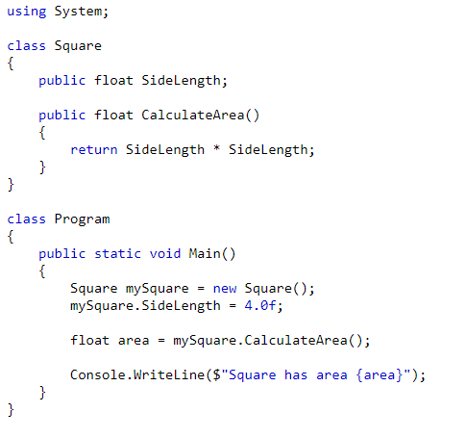

Example
Here is a simple class and a program which uses it (also notice how the program itself is a class):
Output:

Slide 5
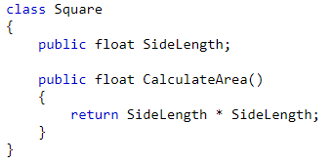
Lets examine the previous example
A new class type is defined with the class keyword and a name for the type. This is then followed by a { } block where the class members are defined.
This creates a new class type called Square. Square contains a data field of the float data type called SideLength. It also contains a method (another name for a function) called CalculateArea which uses the data field to calculate the area and return that to the caller.
We have grouped together the data that defines a type with the code that uses that data.

Slide 6

Lets examine the previous example
This creates an object of type Square, and sets its SideLength data field to have the value 4.0. The dot operator is used to access members of an object. Every Square object has its own SideLength data field, so all can have different values.
This calls the CalculateArea method and assigns it to the area variable. The method is called on the mySquare object, so when the method uses data fields it uses the values that the mySquare object contains.

Slide 7
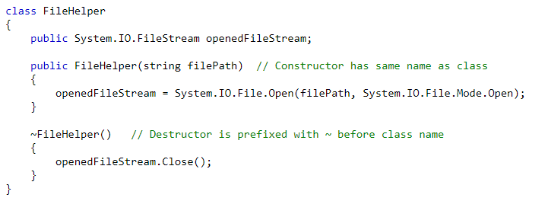
Constructors and destructors
All classes have a constructor method and a destructor method.
The constructor is called when an object is created. Here you can initialise the class. The destructor is called when the object is no longer accessible and the garbage collector deletes the object. Here you can clean up resources the class has in use.
Constructors and destructors have no return type, but constructors can take parameters.

Slide 8
Static members
Usually each object has its own values for the data fields defined in its class, and calling a method calls it only for that object.
Members can be declared as static to be shared across all objects of that class.
Modifying the value of a static data field modifies it for all objects of that class. They can be accessed without an object, by using the class name.
Static methods can be can be called without an object, they can be called using the class name. Static methods cannot reference non-static members.

Slide 9
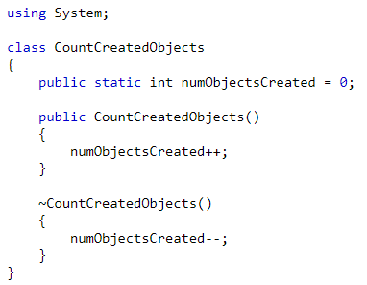
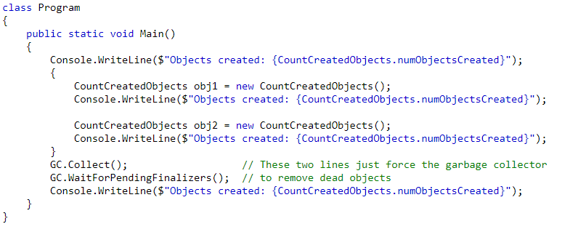
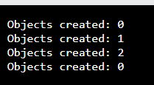
Static members example
Output

Slide 10
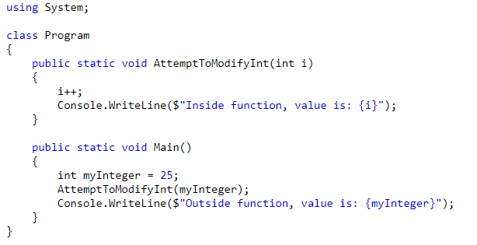

Value types
Primitive types (int, float, char, etc.) are value types. Passing a variable of a value type to a function passes a copy of its value, not the variable itself. Modifying the parameter inside of the function does not change the value of the variable.
Output:
Output:

Slide 11
Reference types
Objects are reference types. When an object is passed to a function, a reference to the original object is passed, so modifying the parameter modifies the original object.
You can’t assign a new object to the variable referring the original object, you can only modify the object it already refers to.

Slide 12
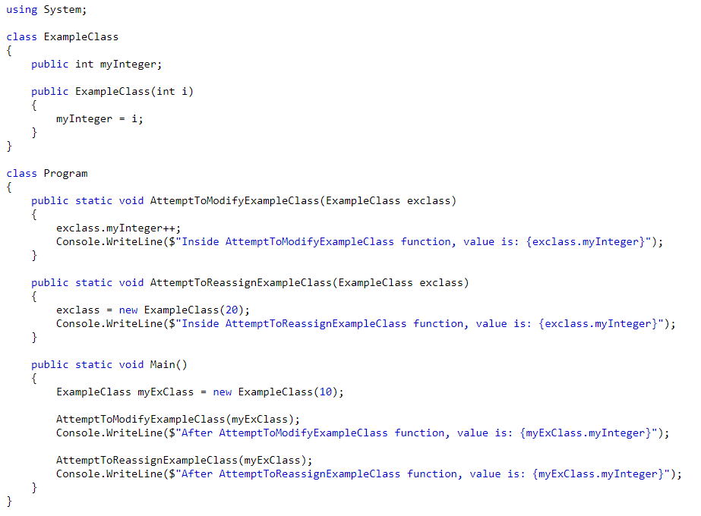

Reference types example
Output:

Slide 13
Encapsulation
The user of a class should know what the class can do, but not how it does it. This means when a class implementation changes, users of that class do not also need to be modified.
It also prevents the object’s state being modified erroneously. We can make sure that only the object can modify its own data.
We can hide members of a class so they are only visible within that class.
C# has the following access modifiers for class members:
public – all code can see this member
private – only code within this class can see this member
protected – only code within this class or its derived classes can see this member (derived classes will be explained soon).

Slide 14
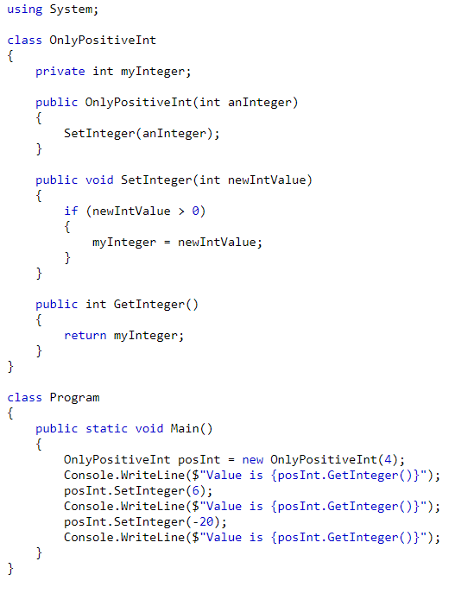
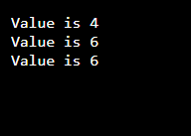
Encapsulation example
Because we now control access to myInteger, we can make changes to how this class is implemented without breaking other parts of the code.
For example we could add a log a warning every time a negative number is passed to SetInteger. If myInteger was public we would need to add logging code everywhere else it was accessed.
If we wanted to rename myInteger, we would only need to update references in this class, we won’t break code elsewhere.

Slide 15
Inheritance
A class can inherit public and protected members from another class. When it does so we call the class that is being inherited from the base class, and the new class the derived class.
Inheritance is used to create types that share the behaviour of the base class, but extend upon that behaviour. It creates an ‘is a’ relationship between the two, where the derived class ‘is a’ whatever the base class represents, but is often more specific.
For example if we had an FileReader class, we could create a JpegReader class that inherits from it. The JpegReader ‘is a’ FileReader, and has the same public methods (or maybe even adds more), but has a different implementation.
We can override methods inherited from the base class to give them a new implementation. If we don’t then the derived class keeps the base class implementation.

Slide 16
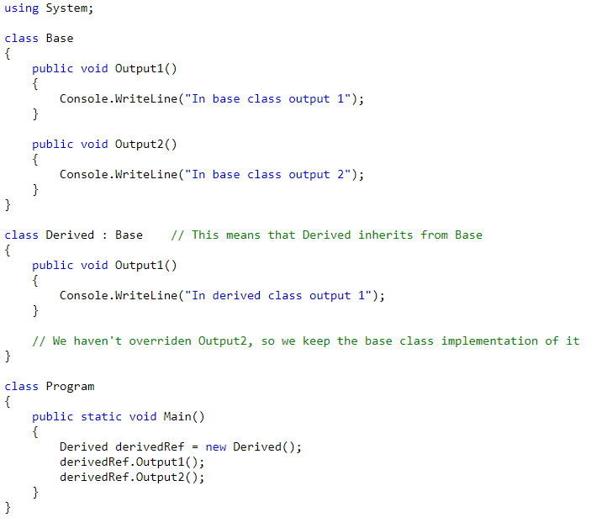
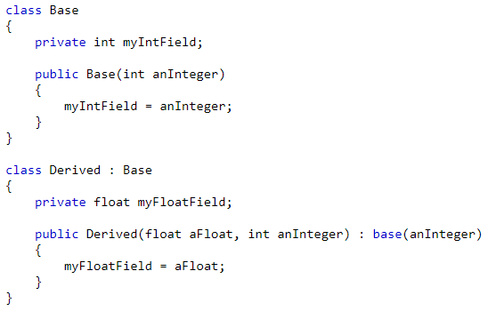

Inheritance example
If the base class has a constructor it must be called by the derived class constructor. Use the base keyword for this.

Slide 17
Polymorphism
Polymorphic behaviour means that a reference variable to a base class can also refer to any of it’s derived types. We can substitute the derived class in anywhere we could use the base class.
For example, if we have a Shape class and a Square class that inherits from Shape, we can create a Shape variable and assign to it a Square object:
Or we can pass Square objects to a function that takes a Shape parameter.
If we declare a class method as virtual and override it in the derived class, then when that method is called via a base class reference variable the derived class implementation is called.
For non-virtual functions the base class implementation would be called.
Usually methods which will be overridden are declared as virtual.
We need to use the override keyword to override a virtual method.
Shape someshape = new Square();

Slide 18
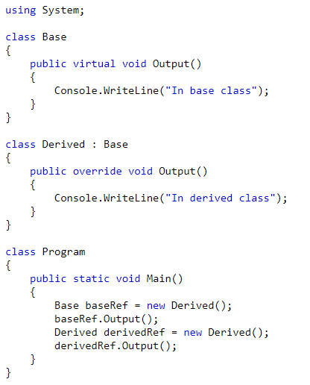
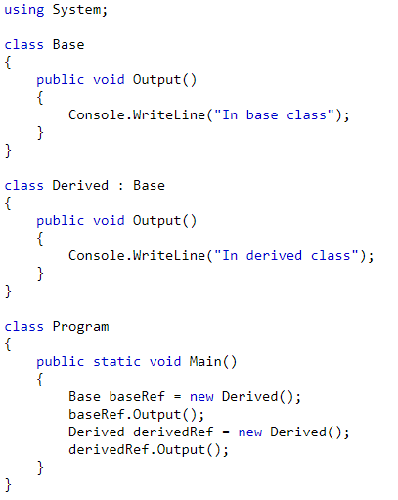


Virtual

Slide 19
Interfaces
An interface is a class that contains only abstract methods. An abstract method is a method with no function body.
You cannot create new objects of an interface type, but you can inherit a class from an interface. A class that inherits from an interface and defines each method with a function body can have object instances created of it.
You can create a reference variable of an interface type and assign to it a derived class object.
Interface members are public by default.
You don’t need to use the override keyword to implement an interface method.

Slide 20
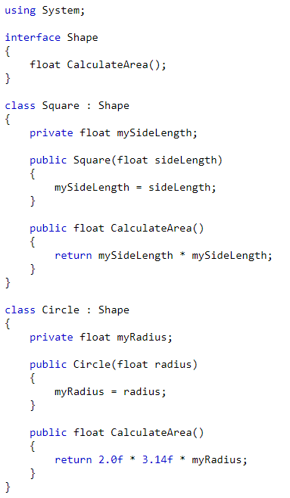
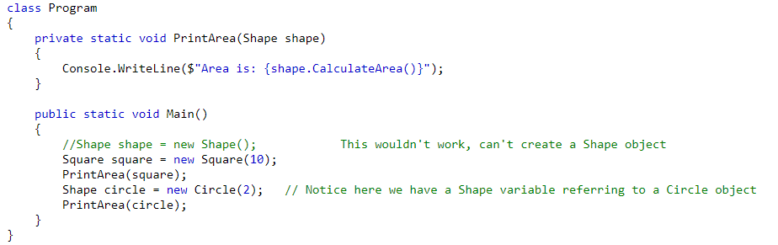

Interfaces example
Output:

Slide 21
Summary
Object oriented programs are made of many objects that all interact with each other to produce useful behaviour.
A class is a blueprint for an object. It defines what a class is and what it can do.
Public members are accessible by other classes. These members let the other classes know how to interact with the object.
Private members allow a class to hide its implementation details from other classes. This means we can protect the object’s data, and we can also change implementation details without breaking other classes.
Classes can inherit from each other to extend upon the functionality of it’s base type.
Derived types can be used wherever a base type could be used. This lets us write code that depends on certain class functionality being available, but doesn’t care about how that functionality is implemented.

